Slide 1
Deep Learning Crash Course
By : Vishwas Narayan

Slide 2
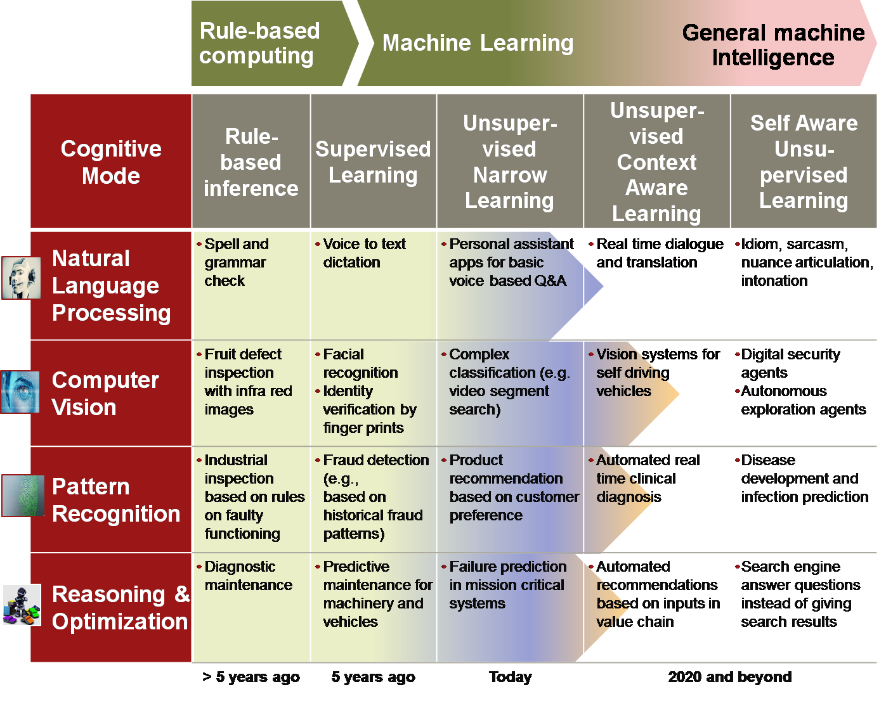
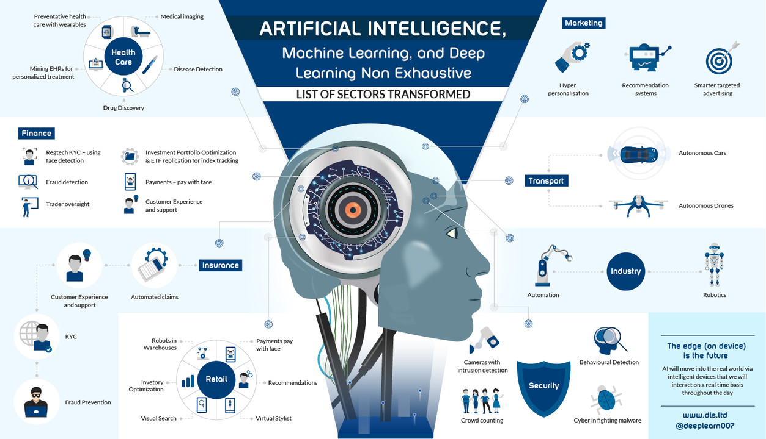
Deep Learning is Everywhere

Slide 3


Slide 4
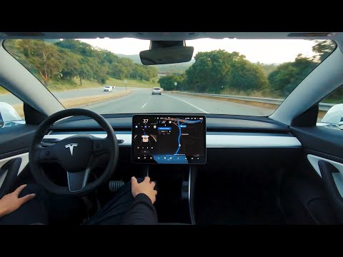

Slide 5
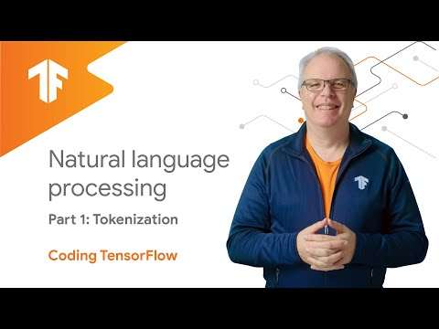

Slide 6
What you should Learn is to
Build a groundbreaking intelligence just like humans through Deep Learning
Build Neural Network with your approach and also make them make some sustainable Decision
Understand and give your own approach to give a effective training for the deep learning model

Slide 7
What is the Difference between the Ai and others
Like
Deep Learning with ML and AI
Machine Learning with AI
Here never forget somehow you train to get the model

Slide 8
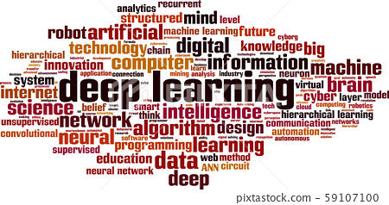
What you will learn?
Loss Function and Optimizers
Gradient Descent Algorithm
Neural Network Architecture

Slide 9
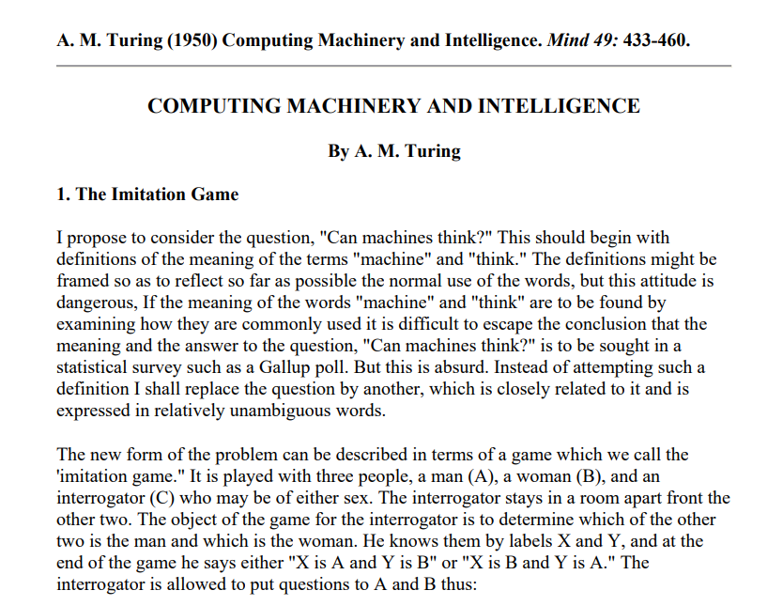
What is Deep Learning?
Microsoft Word - Turing Test.doc (umbc.edu)
Notes:
Microsoft Word - Turing Test.doc (umbc.edu)

Slide 10
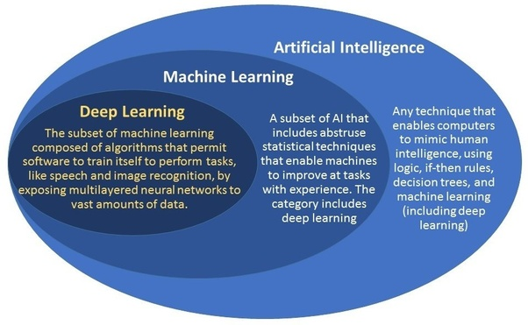

Slide 11
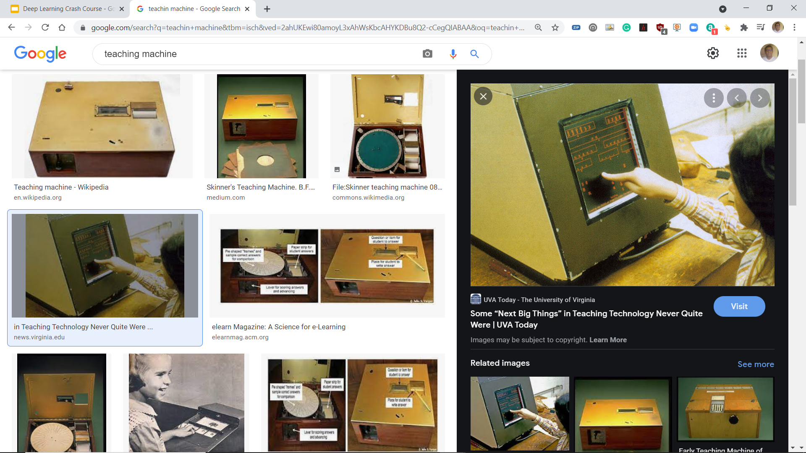
Machine learning is basically
Teaching machine learn patterns in data

Slide 12
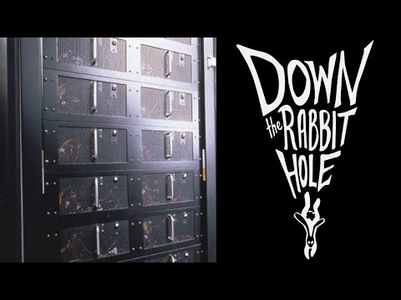

Slide 13


Slide 14


Slide 15
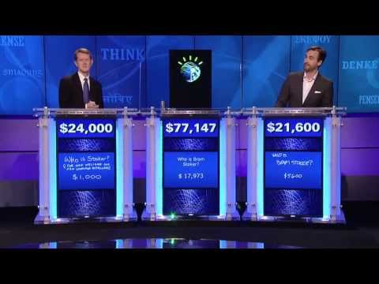

Slide 16
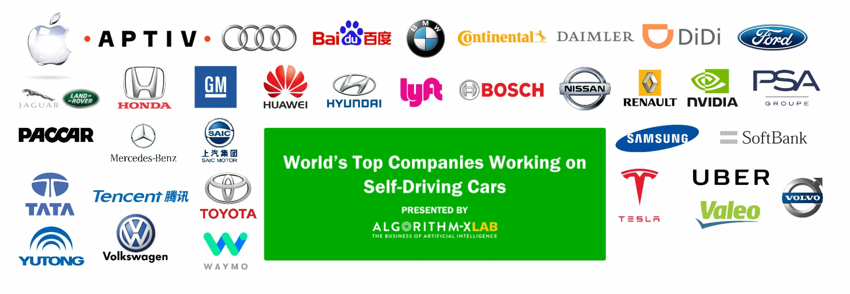

Slide 17
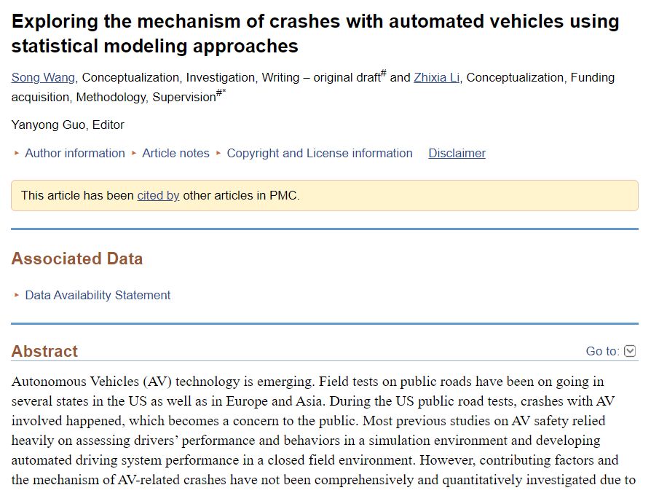

Slide 18
What is Deep Learning
A Machine learning Technique that learn features and tasks directly from data.
Inputs are run through “Neural Networks”
Neural Network have hidden layers

Slide 19
Why Deep Learning?
Machines never get Fatigue.
They need to get trained from the Human intelligence -
They just fetch patterns.

Slide 20
In Deep Learning
Features can be learnt from Raw Data

Slide 21
What they Really mean to us?
X
Black Box
Some functional Output
Y
Some functional Output that is inspired by brain
Neuron
X
Y

Slide 22
Traditionally
DATA
Output
Algorithm

Slide 23
DATA
Output
Algorithm

Slide 24
DATA
Model
Output
DATA
Predictions
Model

Slide 25
Insight
Intent
DATA
Neuron
Model
Output

Slide 26
Why do we need now?
Data is Prevalent?
Improved Hardware Architecture
New Software Architecture

Slide 27
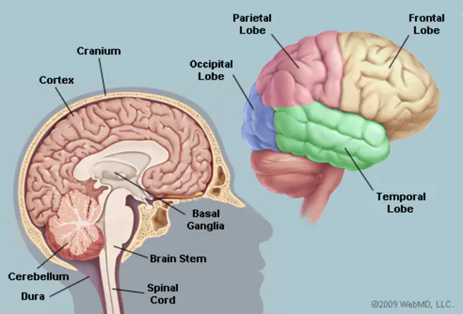
Neural Networks
Inspired by the Neurons on the Brain.

Slide 28
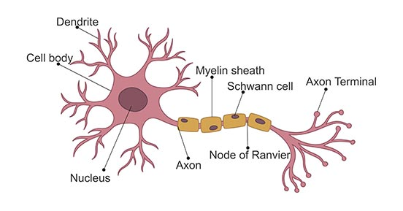
Building Block of the Neural Network is
Neuron

Slide 29
Neural Network
Take data as the input
Train themselves to understand the patterns in the data

Slide 30
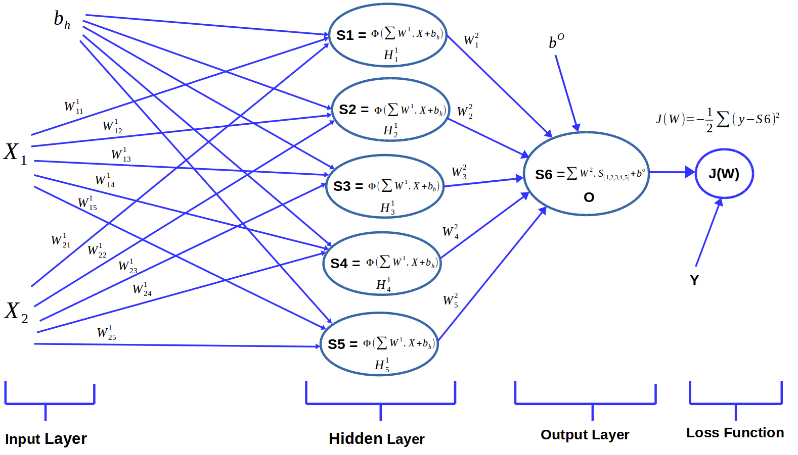
A simple Neural Network

Slide 31
Learning Process of the Neural Network
Learning Process of the Neural Network
Forward Propagation
Back Propagation

Slide 32
Forward Propagation

Slide 33
Weights and Biases
Weights - How important information can this neural network can get
Bias - allow the right decision to be taken into consideration

Slide 34
Back Propagation
Feedback loop

Slide 35
In Backpropagation
Loss function helps the Neural Network Quantify the deviation front he expected output.

Slide 36
Randomly Initialize the Parameters

Slide 37
Back Propagation
Use of the Loss Function
Go Backwards and self tune the initial weights and biases
Values adjusted to better fit prediction of the model that is trained from the data.

Slide 38
Learning Algorithm for the Neural Network
Initialize the parameters with some tuned and calculated value.
Feed Input data to the Network
Compare the Predicted value with the expected data and calculate loss
Perform Backpropagation to propagate this loss back through the network.
Update parameters based on the loss
Iterate the previous steps till the loss is minimized.

Slide 39
Terms used in the Neural Network
Activation Function
Helps to decide whether a Neuron can be a drop out or can contribute to the next layer based on the dataset that it is trained on.
Introduce non linearity into the Neural Network.

Slide 40
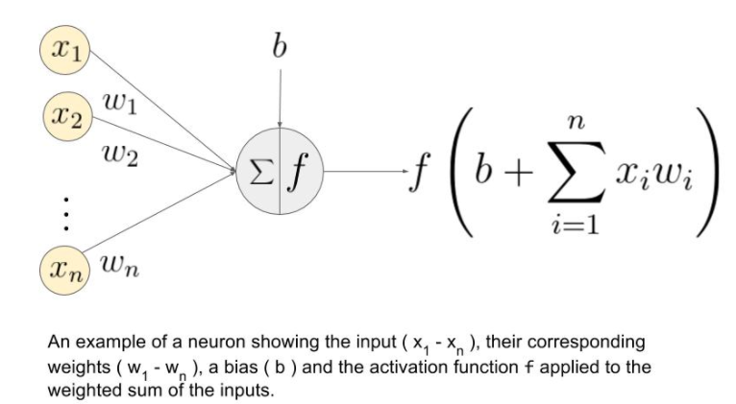

Slide 41
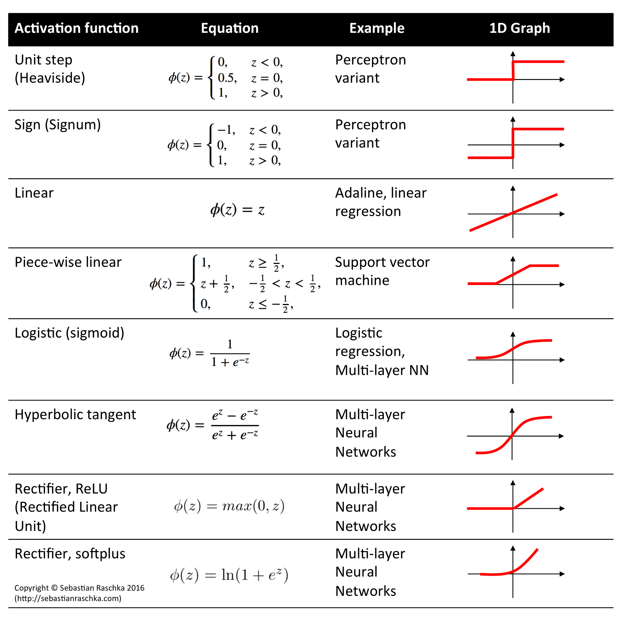

Slide 42
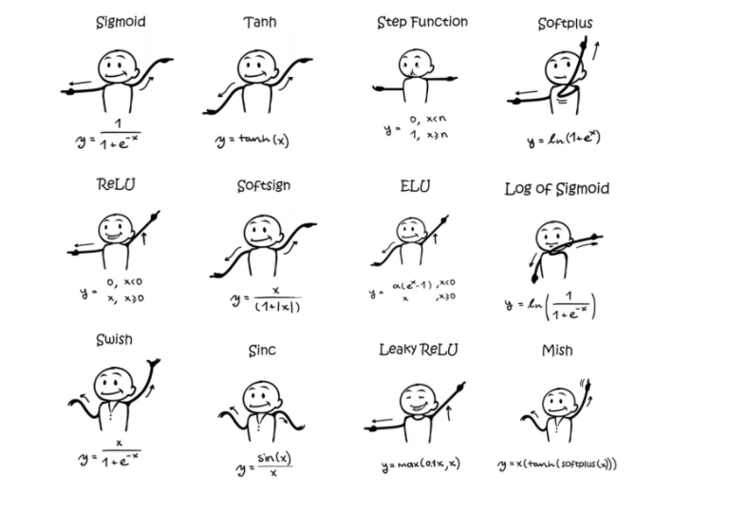
Notes:
Activation Functions In Neural Network | by Gaurav Rajpal | Analytics Vidhya | Medium

Slide 43
Which Activation Function to use?
For the Binary Classification: Sigmoid or the Relu is Used for the best results.
In the case of classifiers, sigmoid functions and their combinations often perform better.
Because of the vanishing gradient issue, sigmoids and tanh functions are sometimes avoided.
The ReLU function is a generic activation function that is employed in the majority of applications these days.

Slide 44
Activation Function Condition
If we have dead neurons in our networks, the leaky ReLU function is the best option.
Remember that the ReLU function should only be utilised in the hidden layers.
As a general guideline, you should start with the ReLU function and then go on to other activation functions if the ReLU function does not produce the best results.

Slide 45
The king here is the data nad queen also
No matter what you are training a model using a dataset that is available for you,Neural Network is as it becomes.

Slide 46
Loss Function
We know that from the Random Weights and Biases the Neural Network Makes decision - Expected Output ,Weights and Biases are calculated.
Thus they Quantify the deviation of the predicted output by the NEural NEtwork to the expected output.

Slide 47
The loss functions in Regression are
Absolute Error Loss
Huber Loss
Squared Error Loss

Slide 48
The loss Function in Binary Classification
Binary Cross Entropy
Hinge Loss

Slide 49
Multi Class Classification loss functions
Multi-Class Cross Entropy Loss
KL(Kullback–Leibler) Divergence

Slide 50

Optimizers
During the Training process we will adjust the parameters to minimize the loss function and make our model as optimized as possible for the Use.

Slide 51
Optimizers are basically
A function that combines to the loss function and model parameters by updating the Neural Network based on the output of the Loss Function.

Slide 52
Gradient Descent
Iterative function that starts off at a random Point on the loss function and travel down its slope in steps(learning rate -from user) until it reaches the lowest point of the function.
Again this depends on the data.but they are
Most popular optimizer
Fast,Robust,Flexible.

Slide 53
Algorithm in the Lay man Terms
Calculate what a small change in the each individual weights would do to the loss function
Adjust each parameter based int eh its gradient(differential)
Repeat Steps one and Two until lower loss function is calculated by the Neural Network.
Notes:
Calculating Gradient Descent Manually | by Chi-Feng Wang | Towards Data Science

Slide 54
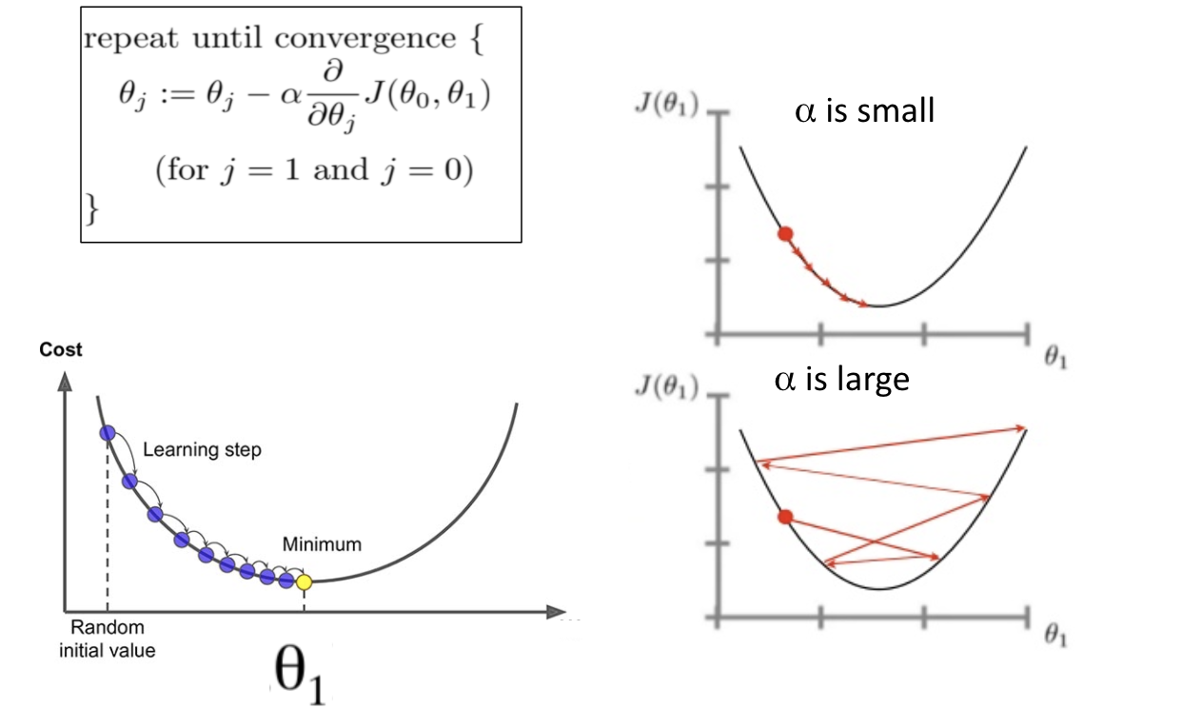
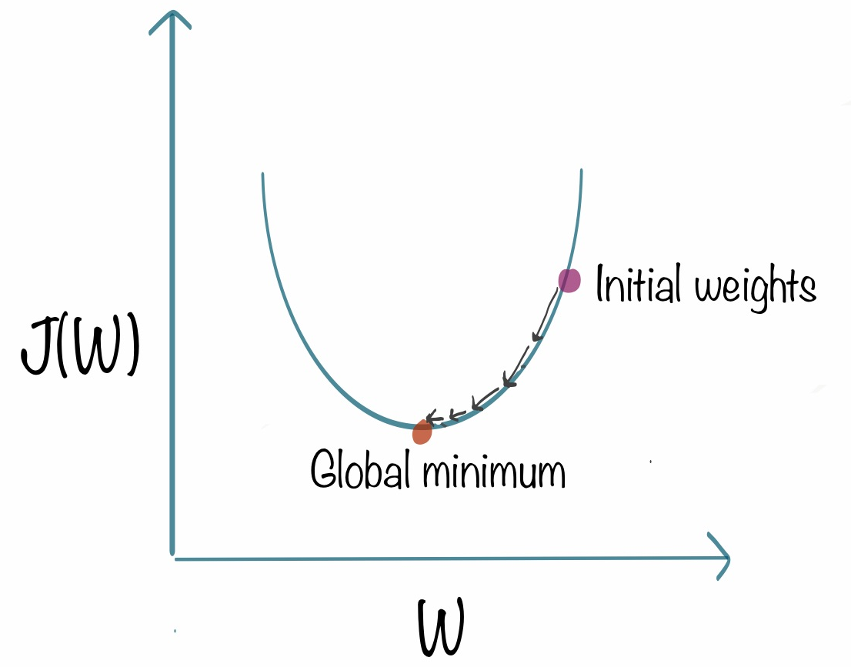

Slide 55
To avoid getting stuck in the local minima
We use Learning Rate
Usually a small number that is multiplied to the scale of the gradients,which is any changes made to the weights are quite small.
If we take large steps as learning rate then algorithm will tend to overshoot the global minimum
Where we also don't want the algorithm to take forever to train and converge to the Global minimum.

Slide 56
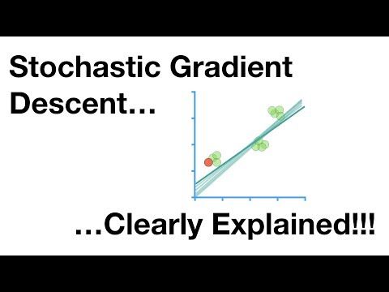

Slide 57
They are more robust ,why?
Like Gradient Descent,Except uses a subset of training example rather than the entire lot.
SGD is Gradient descent that uses batch on each training.
Use of the Momentum to Accumulate gradients.
Less intensive computation as they are batched.

Slide 58
Backpropagation
A simple implementation of the Gradient descent on the neural network.

Slide 59
AdaGrad
Adaptive learning rate to individual features.
Some weights will have different learning rates
Ideal for the Sparse datasets with many input examples missing
Learning rate tends to get lower accordingly.

Slide 60
Parameters and Hyperparameters
What are model parameters?
Variable from the neural Network whose values can be estimated from the data.
Required by the model to make prediction
Value define the learnt parameters from the data.
Not set manually.saved as the Neural Network is trained.
Example - Weights and Biases.

Slide 61
What are model Hyper parameters?
They are configured externally to the neural network : Value cannot be estimated until we train the dataset on the neural network
No clear way to find the best value
When the DL algorithm is tuned ,you are really tuning the hyperparameters.
This is tuned manually
Example - Learning Rate,C and Alpha in SVM,Epochs,k in the kNEes

Slide 62
Summary
Model parameters -> Estimated front the data
Model Hyperparameters -> Can't be estimated from the data
HyperParameters are often called as the parameters as they are a part of the Machine Learning that must set manually and tuned.

Slide 63
Epochs,Batches,Batch Size and Iterations
Need to learn to do this to your Neural Network when the dataset is too Big.
Break the dataset into smaller chunks and feed those chunks to the Neural Network One by One.

Slide 64
Epochs
When the Entire dataset is passed forward to the Neural Network and only once they get trained in the Network.
We use more than one epoch to help model generalize better and accurate.
There is no absolute count for the dataset as its different for different datasets.

Slide 65
Batch and Batch size
We divide large dataset into the smaller batches and feed those batches to the Neural Network
Batch Size - Total number of the training examples in the Batches.

Slide 66
Iterations
Number of Batches needed to complete one epoch
Number f batches = Number of iterations in one epochs

Slide 67
Let's have some more insights
Suppose we have 1 million Number if dataset as the Training Example and you divide the dataset into the batches of 500 ,to Complete 1 Epoch ,it would take 20000 iterations.

Slide 68
Conclusion for the terms used in NN’s
How to design an Architecture?
Which Activation Function to use?
The only thing is to

Slide 69
Types of Learning
There are Three Main Types -
Supervised Learning
Unsupervised Learning
Reinforcement Learning

Slide 70
Supervised Learning
Algorithms designed to learn from Examples.
Models are trained on well-labelled data
Each example has
Input Object - Typically a Vector
Desired Output Value Supervised Signal

Slide 71
During Training
Searches the pattern and correlate with the desired output.

Slide 72
After Training
Takes the unseen inputs and determine which label to classify it to.

Slide 73
Objective of a Supervised learning model
Is to predict the correct label for the unseen data.

Slide 74
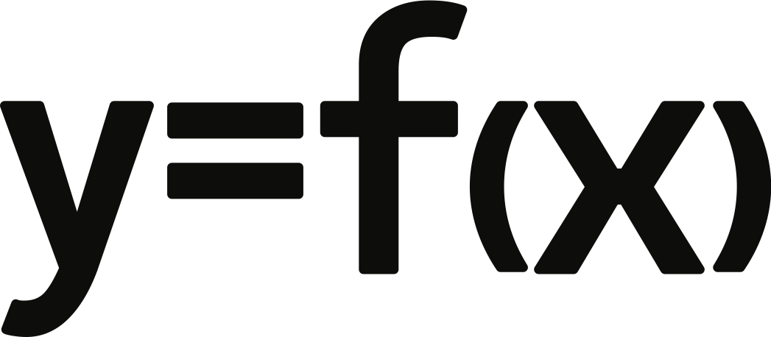

Slide 75
Supervised learning is of two types
Classification
Regression

Slide 76
Classification
Take Input data and assign it to a class/category.
Models finds features in the data that correlates to the class and creates a mapping function
This mapping function will be used to classify unseen data from testing and the validation set from the cross validation of the data

Slide 77
Binary and Multiclass classification
Definition and Example

Slide 78
Popular Classification Algorithms
Logistic Regression.
Naïve Bayes.
Stochastic Gradient Descent.
K-Nearest Neighbours.
Decision Tree.
Random Forest.
Support Vector Machine

Slide 79
Regression
Model tries to find a relationship between dependent and independent variable.
Goal is always to predict continuous values such as a test score.

Slide 80
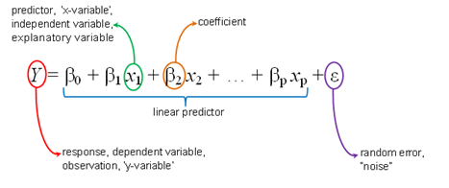
Equation is always continuous

Slide 81
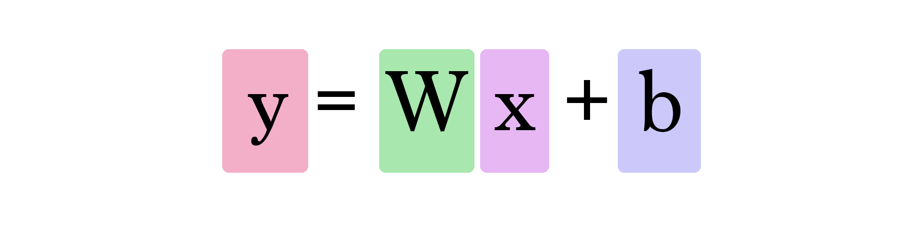
Simple Linear Regression

Slide 82
Different Regression Algorithm
Linear Regression.
Logistic Regression.
Ridge Regression.
Lasso Regression.
Polynomial Regression.
Bayesian Linear Regression.

Slide 83
Application of Supervised Learning
Text categorization
Face Detection
Signature recognition
Customer discovery
Spam detection
Weather forecasting
Predicting housing prices based on the prevailing market price
Stock price predictions, among others

Slide 84
Unsupervised Learning
Uses to manifest underlying pattern in data
Used in Exploratory Data Analysis
Need no labelled data,they use the feature from the Data

Slide 85
Unsupervised Learning is of
Clustering
Association

Slide 86
Clustering -Partitional Clustering
Partitional Clustering
Each Data point can belong to a single cluster

Slide 87
Clustering - Hierarchical Clustering
Clusters within the clusters
Datapoint may belong to different clusters

Slide 88
Association
Attempts to find different relationship between the different entities.
Example - Market Basket Analysis

Slide 89
Some Clustering Algorithm
Clustering Dataset
Affinity Propagation
Agglomerative Clustering
BIRCH
DBSCAN
K-Means
Mini-Batch K-Means
Mean Shift
OPTICS
Spectral Clustering
Gaussian Mixture Model

Slide 90
Application of the Unsupervised Learning
Fraud detection
Malware detection
Identification of human errors during data entry
Conducting accurate basket analysis, etc.

Slide 91
Reinforcement Learning
Enable the intelligent entity to learn in an interactive environment by trial and error(by Policy and reward network) based on its own actions and experience.
This is a very new way of getting the things learnt.
If your Neural Network doesn't work well then you have to use the Reinforcement :Learning.

Slide 92

Reward and Punishment is the key here
Uses the positive and negative signals as the behavior to understand what has been learnt.

Slide 93
Goal of Reinforcement learning is to
Find a Suitable model that would maximize the total cumulative reward and make a very approximate result that might help in making some more discussion.
Maximize the points won in a training over many examples
Penalize when they make wrong decisions
Reward where they make Right decision
Usually modelled as a “Markov Decision Process”

Slide 94
Penalty/ Reward
Next State
Action

Slide 95
Application of the Robotics
Robotics
Business strategy
Traffic Light Control
Web system configuration
NLP
to personalize suggestions
deliver more meaningful notifications to users
optimize video streaming quality.
Gaming
Bidding

Slide 96
Some core and Canonical Problems in Deep Learning
Basically we find this as the situation:
Model should perform well on training data and new test data
Most common problem faced will always be overfitting

Slide 97
So the data points as the example is here
Data is Skew
Data is Random
They don't care anything and anybody they are just generated
They are collected to make sense and make a model
They are collected to make the right decision from the model

Slide 98
Underfitting

Slide 99
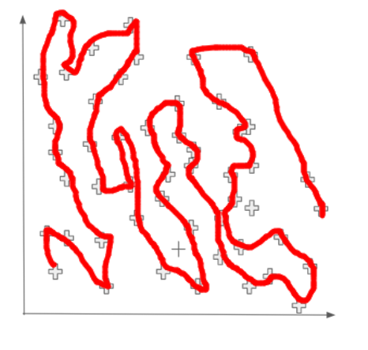
Over-fitting

Slide 100
Tackling Overfitting is
1. Hold-out
2. Cross-validation
3. Data augmentation
4. Feature selection
5. L1 / L2 regularization
6. Remove layers / number of units per layer
7. Dropout
8. Early stopping

Slide 101
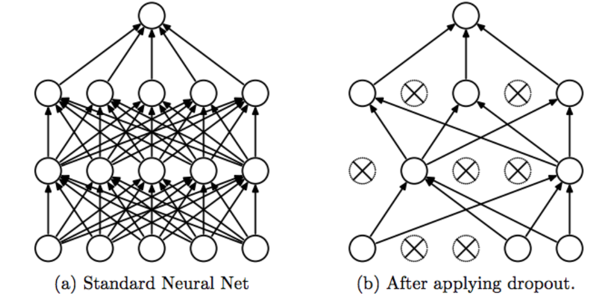

Slide 102
Data Augmentation
Just create some fake data as much as possible from the data itself.

Slide 103
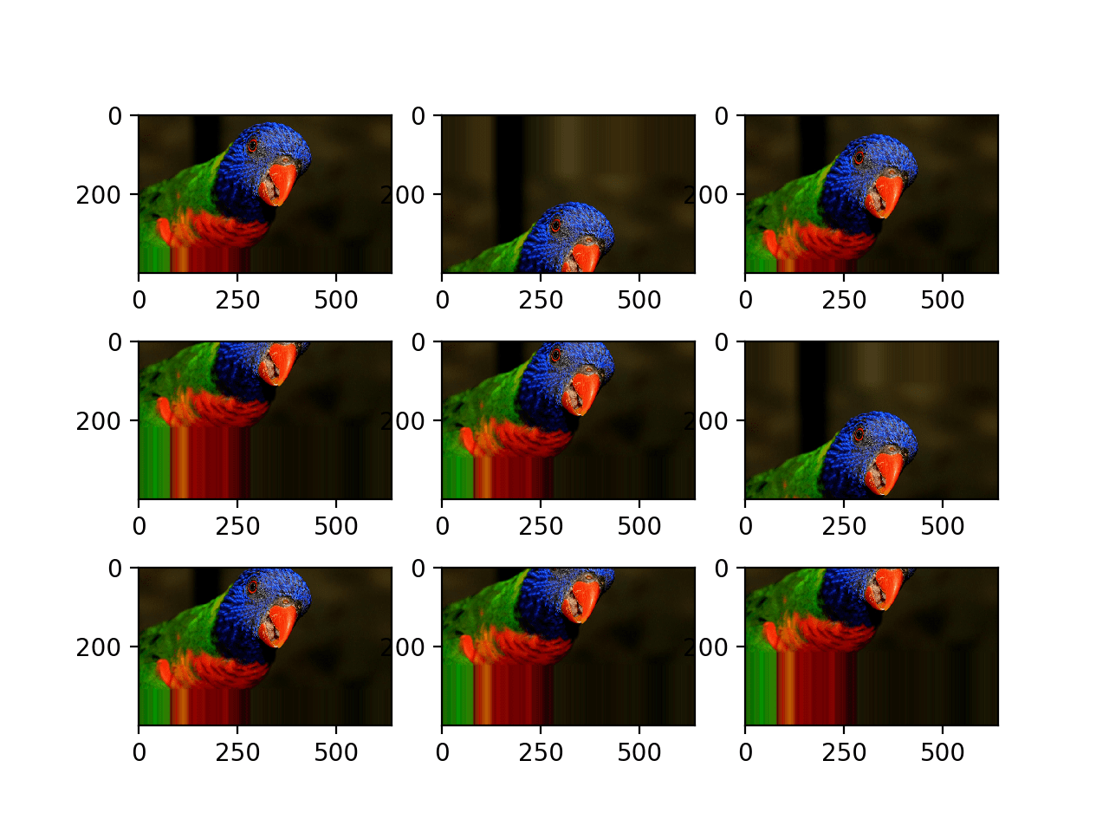

Slide 104
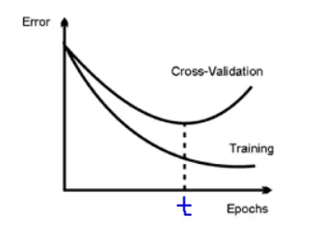
Early Stopping
Use Early Stopping to Halt the Training of Neural Networks At the Right Time (machinelearningmastery.com)

Slide 105
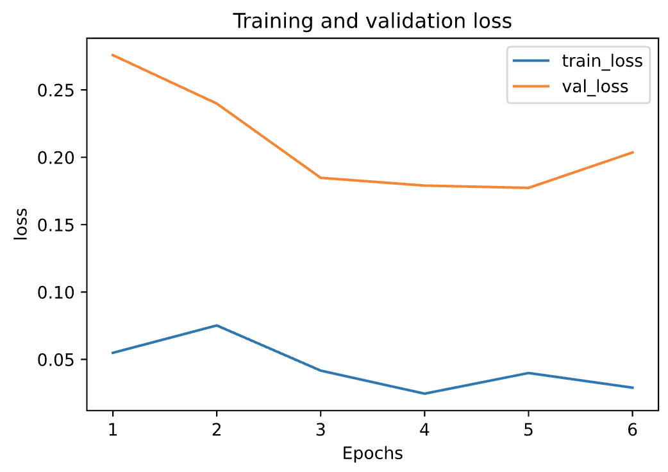
When do you need to do this?
Training error decreases steadily but the validation error increases after a certain point.

Slide 106
Neural Network are in plenty
So go the sources that I am saying in this stream.

Slide 107
So we talked a lot about the models
So now let's get to know how we can build a model.

Slide 108
Gathering Data
Picking the right data is very important,Good way to start is you need to make assumption about the data that you need.

Slide 109
Size of the data set also matters
No one size fits all
Amount of the data needed = 10 times the model parameters

Slide 110
Quality of the data also matters
Data has to be more Accurate and Reliable with no Adversaries.
Noiseless Features.

Slide 111
Some Dataset Repositories are
I will list out here.

Slide 112
Pre- Processing dataset
Split the dataset into the subset.
Training data set
Testing Data Set
Validation Data Set
We can randomly split the dataset

Slide 113
This process depends on
Number of the samples in eh data
Model Being Trained

Slide 114
Simple rule of thumb
Few Hyperparameters means small validation set
Many hyperparameters means large validation set

Slide 115
The ratio in which you split the dataset is specific to your
Use Case

Slide 116
Dataset
Train
Test
Train
Test
Validation
Folds

Slide 117


Slide 118
Look for the missing data
Nan or Null
Eliminated Features or the Missing Value
Impute the Missing data

Slide 119
Sampling
Use a sample of the dataset

Slide 120
Why we need this
Faster Convergence
Reduces the Disk Space

Slide 121
Preprocessing is Required for the FEature Scaling
Crucial Step for the Model TRaining:
Normalization
Standardization
Then obviously train and Evaluate.

Slide 122
Optimization
Will be Continued ...

